Slide 1
♻EcoSort AI Intelligent Waste Segregation and Recycling Assistant
Submitted under: 1M1B – AI for Sustainability Virtual Internship (In collaboration with IBM SkillsBuild & AICTE)
Name: Mohammed Saad College: Marri Laxman Reddy Institute Of Technology And Management

Slide 2
PROBLEM STATEMENT
Improper waste segregation is one of the major environmental challenges today.
Most people:
Do not know how to correctly segregate waste
Mix recyclable, biodegradable, and hazardous waste
Contribute to landfill overflow and pollution
Lack awareness of proper recycling and disposal methods
Struggle to identify hazardous and electronic waste correctly
This leads to:
Reduced recycling efficiency
Environmental degradation
Increased waste management costs

Slide 3
Target Users
EcoSort AI is designed to help various stakeholders involved in waste management and sustainability.
1. Households & Families
Helps users identify waste categories correctly.
Encourages responsible disposal habits.
Reduces household waste contamination.
2. Students & Educational Institutions
Creates awareness about waste segregation.
Acts as an educational sustainability tool.
Encourages eco-friendly behavior among youth.
3. Offices & Commercial Spaces
Improves workplace waste management.
Reduces mixed waste generation.
Supports corporate sustainability initiatives.

Slide 4
Sustainable Development Goal Alignment
EcoSort AI is aligned with:
🎯 Primary SDG:
SDG 12: Responsible Consumption and Production
Promotes correct segregation of waste at the source
Reduces contamination in recycling systems
Encourages responsible disposal habits among citizens
🌱 Contribution:
EcoSort AI promotes responsible waste segregation, reduces landfill waste, and encourages sustainable consumption habits.
Reduces landfill waste accumulation Improves recycling efficiency and resource recovery
Encourages sustainable behavior through AI guidance

Slide 5
Why AI?
🤖 Why Artificial Intelligence?
Traditional waste segregation methods often depend on human knowledge and manual decision-making, which can lead to errors and improper disposal.
Challenges with Traditional Methods
People often cannot identify waste categories correctly.
Disposal guidelines are not easily accessible.
Manual classification is time-consuming.
Benefits of Using AI
Provides instant waste classification.
Generates intelligent disposal recommendations.
Analyzes environmental impact automatically.
Why AI is Necessary
Improves accuracy in waste segregation.
Enhances user awareness and education.
Enables personalized sustainability guidance.

Slide 6
Design Thinking Process
1. Empathize
Understanding challenges faced by individuals in identifying and disposing of waste correctly.
Lack of awareness regarding waste categories.
2. Define
Clearly identifying the core problem.
Improper waste segregation.
3. Ideate
Generating innovative AI-based solutions.
AI-powered waste classification.
4. Prototype
Building a functional solution.
Streamlit-based user interface.
5. Test
Evaluating and improving the solution.
Testing different waste items.

Slide 7
PROPOSED SOLUTION
🤖 AI-Powered Waste Intelligence System
EcoSort AI is an intelligent assistant that helps users correctly identify and manage waste using Artificial Intelligence.
EcoSort AI is an AI-powered assistant that helps users:
Classifies waste into: Recyclable, Biodegradable, E-Waste, Hazardous
Provides safe and practical disposal instructions
Analyzes environmental impact of improper disposal
Generates sustainability-focused recommendations
IBM BOB was used during the project planning phase to explore sustainability-related concepts, refine the problem statement, and validate waste management approaches.

Slide 8
HOW AI IS USED
EcoSort AI uses Artificial Intelligence for:
Waste classification (Recyclable, Biodegradable, E-Waste, Hazardous)
Image recognition of waste items
Environmental impact analysis
Generating smart recycling suggestions
AI Technologies Used:
Large Language Models (LLMs) via Groq API
Prompt Engineering
Vision-based AI for image detection

Slide 9
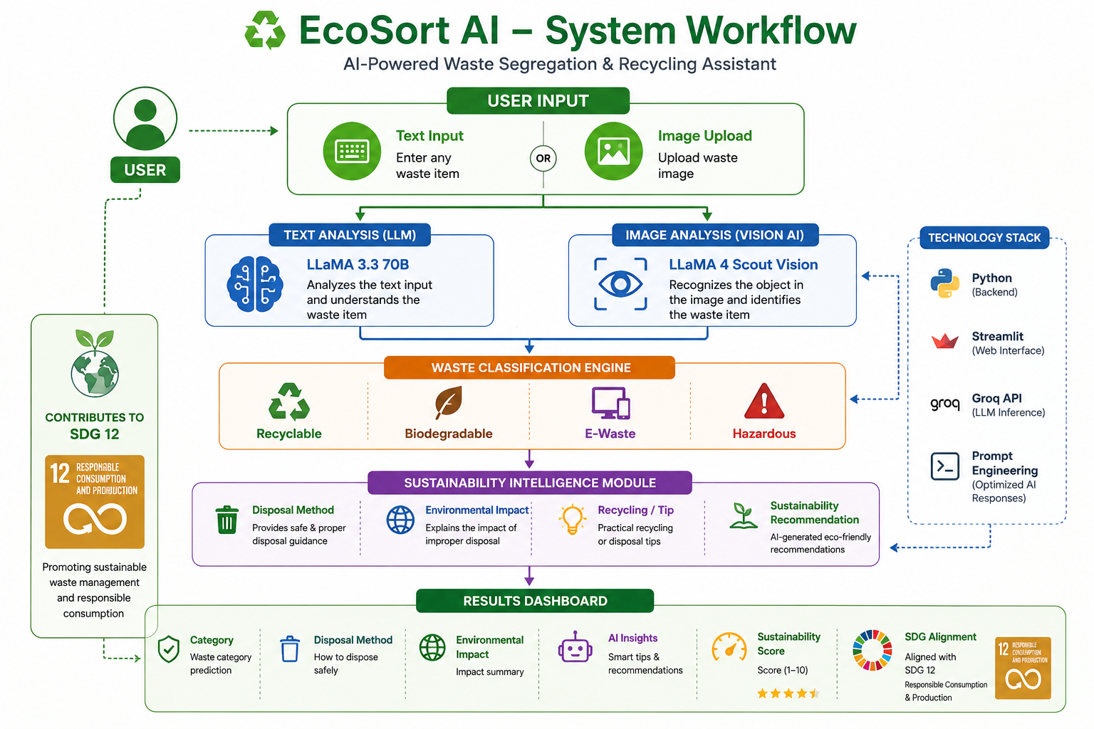
Architecture Of EcoSort AI
Including visuals

Slide 10
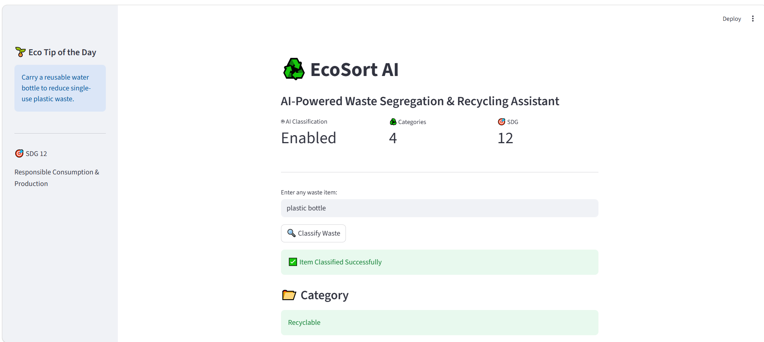
Screen shots

Slide 11
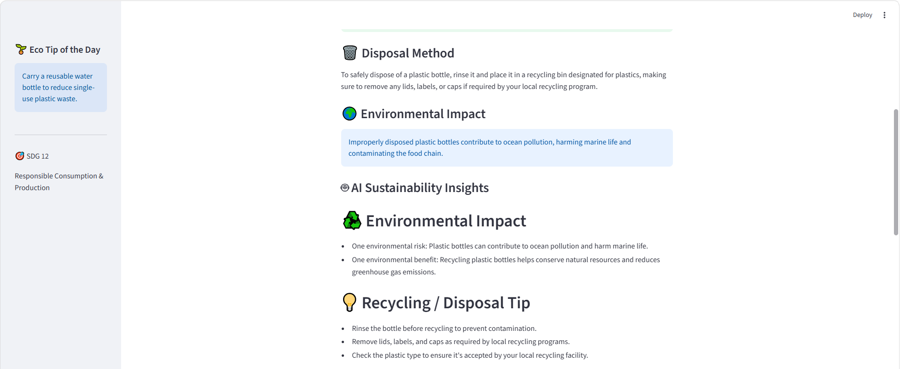

Slide 12
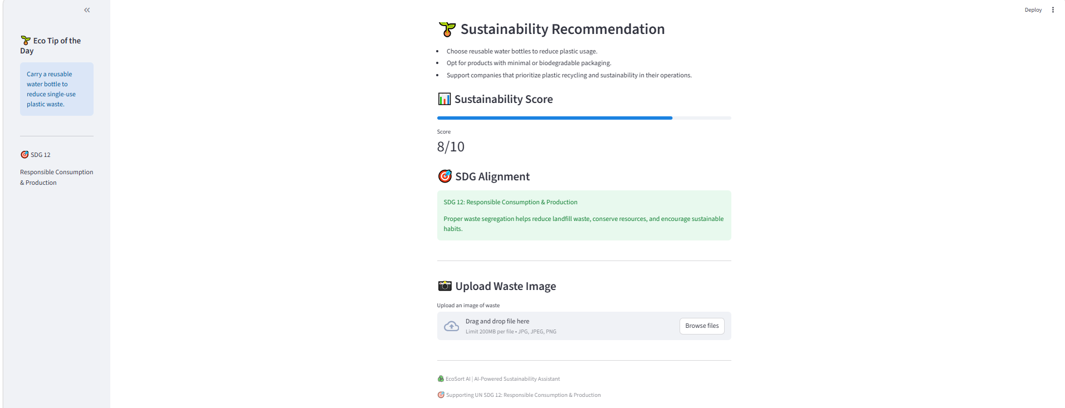

Slide 13
AI MODELS & TOOLS USED
Groq API (LLM inference engine)
LLaMA 3.3 70B model
LLaMA 4 Scout Vision Model
Streamlit (UI development)
Python (backend logic)
Prompt Engineering
Interactive User Dashboard
Computer Vision Techniques
Streamlit Web Framework
Real-Time Sustainability Recommendation System
AI-Based Waste Classification System
IBM BOB (Project Ideation & Sustainability Research)

Slide 14
RESPONSIBLE AI CONSIDERATIONS
EcoSort AI is designed with ethical and responsible AI principles:
🔹 Fairness
Ensures unbiased classification across all types of waste items
Works uniformly regardless of user location or background
🔹 Transparency
AI-generated outputs are simple and explainable
Users are informed about classification and reasoning
🔹 Privacy & Security
No personal data is collected or stored
Image processing is done only for inference
🌱 Overall Goal:
To ensure AI is used safely, ethically, and for positive environmental impact.

Slide 15
IMPACT OF THE PROJECT
🌍 Environmental Impact:
Reduces improper waste disposal
Improves recycling efficiency
Minimizes landfill overflow
👥 Social Impact:
Educates users about waste segregation
Builds environmental awareness among citizens
Encourages responsible daily habits
♻️ System-Level Impact:
Supports smart city waste management systems
Enables data-driven waste processing decisions
Can be scaled for municipal use in the future
🌍 Alignment with United Nations SDGs
Supports SDG 12: Responsible Consumption and Production.
Encourages sustainable waste management practices.
Promotes environmental awareness through AI.

Slide 16
IMPACT OF THE PROJECT
What changes if this solution is implemented?
Improved waste segregation accuracy at the household and community level.
Reduction in recyclable materials being sent to landfills.
Increased public awareness about sustainable disposal practices.
Who Benefits and How?
Households:
EcoSort AI helps families easily identify the correct disposal method for different waste items, reducing confusion and encouraging responsible waste segregation at home.
Students and Educational Institutions: Students gain awareness about sustainable waste management practices and environmental responsibility through an interactive AI-powered learning experience.
Local Communities: Proper waste segregation leads to cleaner neighborhoods.

Slide 17
FUTURE SCOPE
🔮 Future Enhancements
EcoSort AI can be expanded into a large-scale sustainability platform:
📱 1. Mobile Application
Android/iOS app for wider accessibility
Real-time waste scanning using camera
🏙️ 2. Smart City Integration
Integration with smart waste bins
Automated waste collection systems
🤖 3. AI Chatbot Assistant
WhatsApp / Telegram-based assistant
Supports rural and low-tech users
📊 4. Municipal Dashboard
Waste analytics for city authorities
Data-driven waste management planning

Slide 18
📊 Project Outcomes & Sustainability Metrics
The prototype demonstrates how AI can support responsible waste management and sustainable consumption practices.
Key Achievements
Successfully classifies waste into four major categories.
Generates AI-powered disposal recommendations.
Provides environmental impact insights.
Sustainability Benefits
Reduces improper waste disposal.
Encourages recycling and composting.
Supports resource conservation.
Technical Outcomes
AI-driven waste classification system.
Large Language Model integration.
Vision-based waste recognition.

Slide 19
CONCLUSION
🎯 Conclusion
EcoSort AI demonstrates how Artificial Intelligence can be applied to solve real-world environmental challenges.
✔ Key Outcome:
Simplifies waste segregation using AI
Provides instant and accurate disposal guidance
Promotes sustainable and responsible consumption habits
🌍 Final Message:
This project proves that AI is not just a technological tool, but a powerful enabler for sustainability and positive environmental change.
🚀 Vision:
To contribute toward building smarter, cleaner, and more sustainable communities using AI-driven solutions.

